Slide 1

Smart Shopping Cart for Automated Billing Purpose
Dept. of Electronics and Communication Engg.
Mar Athanasius College of Engineering
Kothamangalam
October 2017

Slide 2
Contents
Introduction
Existing technology
Aim of project
Features
Design
Operation
Implementation
Conclusion

Slide 3
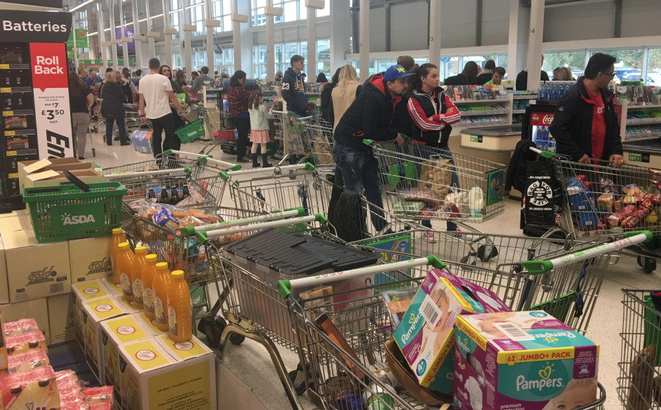
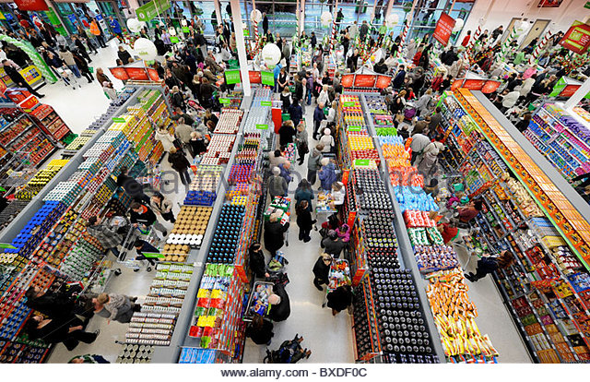
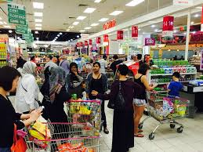
Introduction
Present scenario in shopping malls

Slide 4
The issues faced:
Long waiting time for check-out process
Involvement of lot of man power and energy
Long queue
Cash problems at the time of billing
Pick pocketing due to long waiting hours

Slide 5
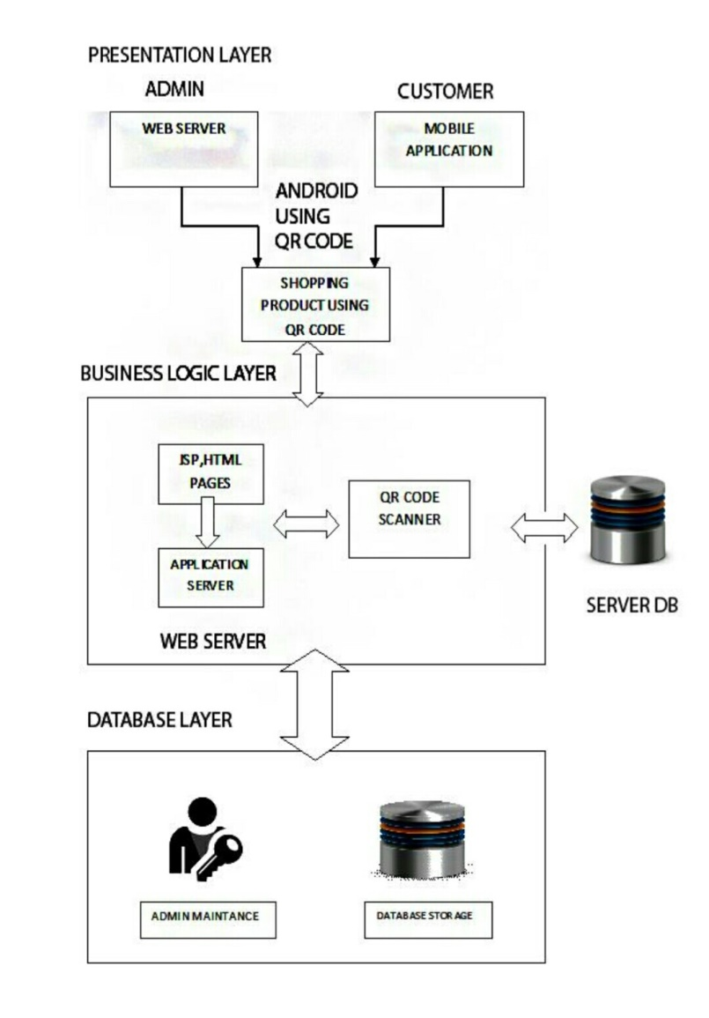
Existing Technologies
Technology 1: By Awati
Reduces man power and long waiting time
Requires the costumers to be honest
Donot tackle the cases of deception
Dependence on android mobile phone

Slide 6
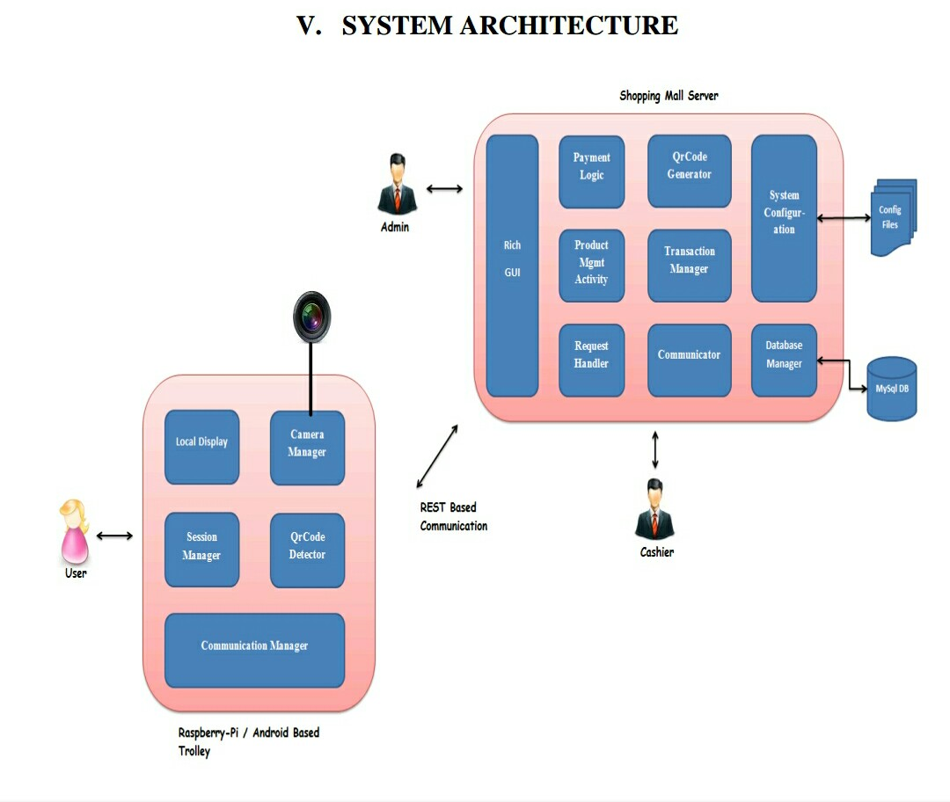
Technology 2: By L.Yew
Customer can see the transactions
Customer can be aware of billing amount
RFID tags are costly
Requires long time to be deployed
Costly in terms of money and energy

Slide 7
Our project aims at:
Creating a better shopping experience to the customers
Minimizes man power as checking out process at checkout counters is eliminated altogether
Cases of deception is reduced thereby making it more friendly to buyers and sellers

Slide 8
Features Of Smart Shopping Cart
1) calculating and updating customers’ bill as and when products are placed in the cart
2) The customer can also track the details of the purchased items as well as the current bill amount on the monitor
3) In includes the handling of the following special cases,
a) Attempt to take away products without scanning their barcodes.
b) When the customer scans a product, but forgets to keep it in the cart.
c) Attempt to scan one product, but place multiple products in the cart.
d) Attempt to take away one product of higher price by scanning the barcode of another product of lesser price.
e) implementation allows for removing any item already placed in the cart, without help from attendant.

Slide 9
The Design Idea
Camera based Barcode Scanner
Required to identify the product
Stores all the relevant information about the product
Database is stored in the base station,which is located in the payment counter
Database includes its barcode,its name,its price and its weight

Slide 10
Contd…
Weight
Double-check the identity of the product
Detect deception in the system
Load cell has been configured as the weight sensor

Slide 11
Contd….
Image Processing
Camera also works as a barcode scanner
Person places the product on the slab once the scanning is done
Another picture is taken just before the slab lets the product into the cart
Both images are stored in the system

Slide 12
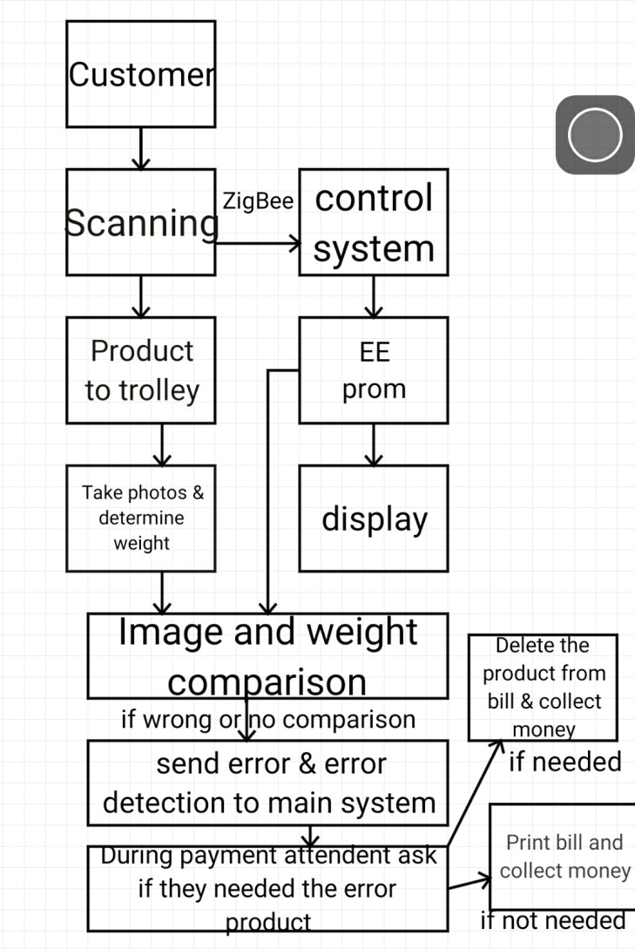
Block diagram

Slide 13
Operation Of The Smart Shopping System
Scans the barcode of the product using barcode scanner
While the customer is scanning the barcode of the product,picture is taken and stored
Barcode and the cart ID are transmitted as two different fields in a single Zigbee
Attendant-flag is sent only in case of discrepancy

Slide 14
Contd…
Another picture is taken just before the slab lets the product in to the trolley
Whether the images match or not, it sets the attendant-flag
Using load cell weight of the product is estimated and transmitted to the base station
Compares the weight
Finally goes to the counter in order to pay bill

Slide 15
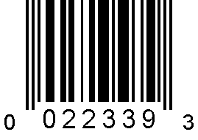
Implementation Details
Barcode scanner
Zbar barcode scanner
Open source software suited for reading barcodes
UPC-E barcode
It also has user interface
Green - proper
Red - improper

Slide 16
Contd…
Weight Sensor
Load cell is used
Transducer – force to electrical signal then to output voltage
Load cell – CZL601
Rated capacity – 3kg
Supply voltage – 9v
Force exerted causes deformation of strain guage
Precision

Slide 17
Contd….
Image comparison algorithm
SIFT algorithm - Scale Invariant Features Transformer
The algorithm is apt for design
The algorithm works even when the object in the two images are not in same size, scale and orientation
Good lighting

Slide 18
Contd…
Sensor mote at Smart cart
Zigbee mote using crossbow technology is used
Connected using USB cable and placed in cart
For monitoring and display purpose
Programmed to calculate weight 2 sec. after product is placed in cart
It transfer all the information to base station

Slide 19
Contd..
Base station
It is the bill counter with a PC
MySQL database is used for implementation
It has table which consist of:
Barcode ID
Name of product
Price
Weight
Alerts attendent in case of discrepancy
Finalise products
Bill is payed here

Slide 20
Contd…
EEPROM
Electrically Erasable Programmable Read Only Memory
Non-volatile memory
To store small amount of data which is important
Like product name and total coast

Slide 21
Contd..
LCD display
In each trolley
To display product name and cost
8051 Microcontroller
8-bit microcontroller
To prefer a total costing of a product

Slide 22
Conclusion
The system is highly reliable ,fair and cost effective
The system is also energy efficient
Decision making process is done within the cart thereby eliminating communication problems
Our implementation make use of simple broadcast technique to communicate

Slide 23
Contd…
Cost effective as a passive sensor(load cell) and a cheap barcode scanner is used
Manpower requirements are reduced
Greater hope for the future

Slide 24
Thank you

